Slide 1
JBL Charge 6 USB Type-C Proposal

Slide 2
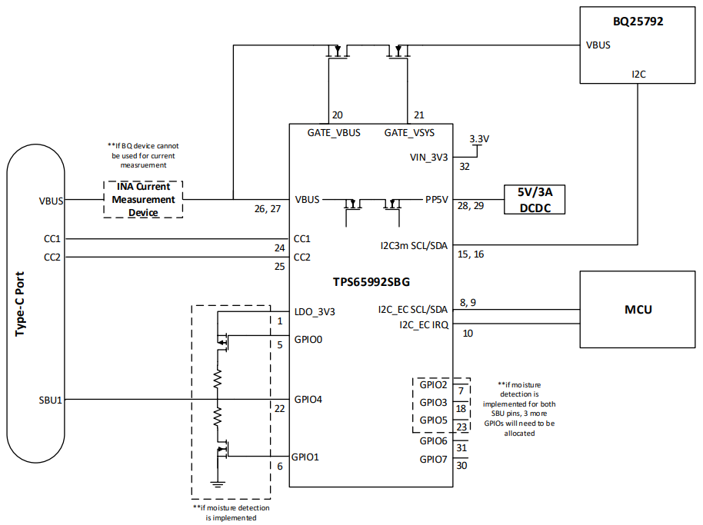
Solution Block Diagram
MCU will connect to I2C_EC channels
I2C_EC_IRQ pin will be used to notify MCU that an interrupt event has occurred
PP5V power path will be used to supply 5V/3A source contracts
External power path will connect directly to BQ25792 and be used for:
All sink power contracts
Source PDO contracts >5V
All PPS source contracts
I2C3m channel will connect directly to BQ25792
External INA current measurement device will be needed if BQ25792 current measurement feature cannot be used
VIN_3V3 input can be supplied by system 3.3V rail

Slide 3
Solution Block Diagram
Presentation Links
Samsung Quick Charge Power Range
I2C_EC_IRQ
Firmware loading and upgrade process
Moisture detection implementation
GPIO Events
Harman Adapter Detected

Slide 4
Samsung Quick Charge Power Range

Slide 5
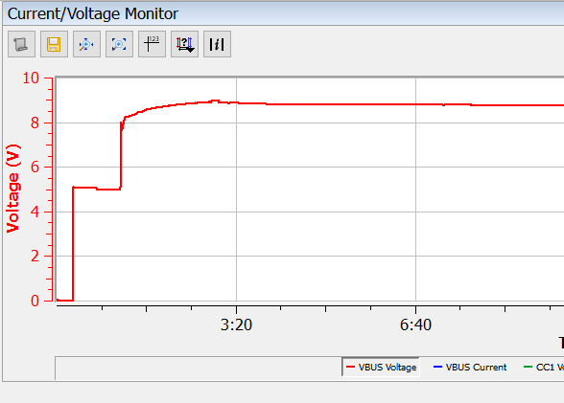
Charging Range for Samsung Quick Charge
The attached Total Phase PD Analyzer log shows a completely dead Samsung S23 being plugged into a wall charger
The phone starts with a steady 5V contract for trickle charge, and then enters into the Samsung quick charge mode.
Even though the battery is completely depleted, it starts its PPS charge at 8V
A Samsung phone will never request a power contract below 5V

Slide 6
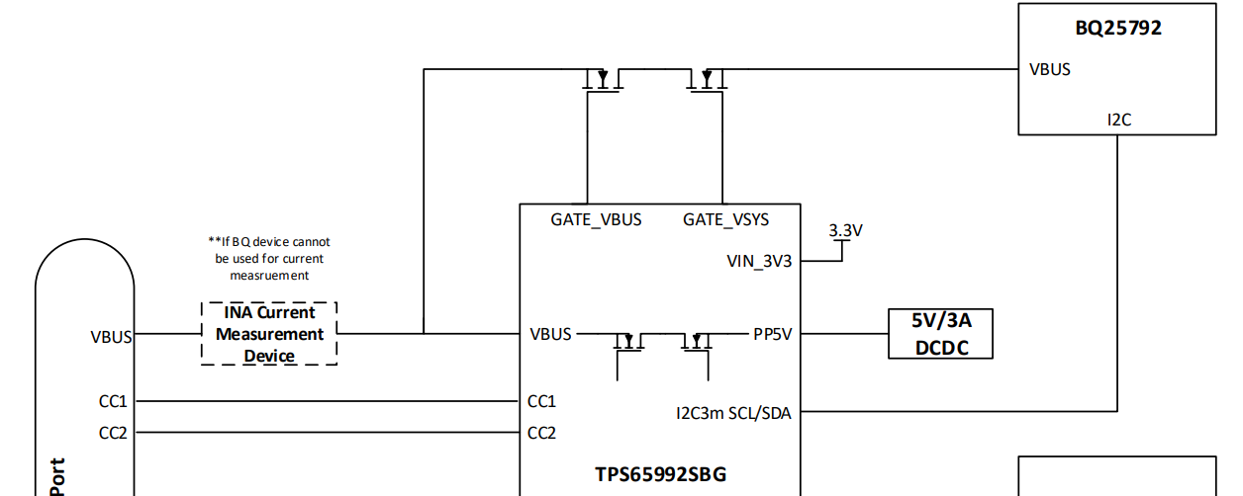
Charging Range for Samsung Quick Charge
Since the Samsung phone will never request power below 5V, the external power path connected directly to the BQ25792 can be used to support all PPS power ranges for Samsung phones

Slide 7
I2C Interrupt Between PD and MCU

Slide 8
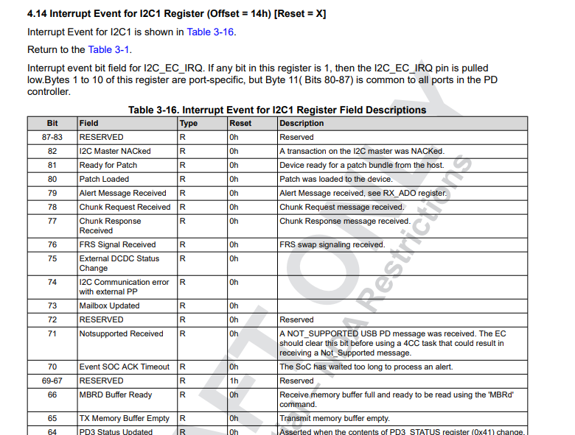
I2C Interrupt
The IRQ pin between the PD controller and MCU is used to notify the MCU that an event has occurred
The interrupt events are set in the GUI, and during run time, will trigger when the programmed even occurs
The MCU reads the register to determine what happened and then operate accordingly

Slide 9
I2C Interrupt Examples
There is a IRQ event that will trigger when a device has been attached to the Type-C port.
IRQ event for new source capabilities message being received
MCU can then go and read register 0x30 (Received Source Capabilities)

Slide 10
Firmware loading and update via I2C (Patch Bundle Mode)

Slide 11
What is the Patch Bundle?
Customer Settings:
Created using the Application Customization Tool (GUI). The host interface technical reference manual outlines all of the configurable registers within the TPS65992, and a vast majority of them can be controlled using our GUI tool.
Firmware Base Image “Patch”:
Implements code to either fix bug issues found in the ROM or implement new features that were not included in the original ROM image.
Patch Bundle:
The combination of the Application Configuration + Firmware Base Image which is generated by the Application Customization Tool (GUI)
TPS65992
RAM
HW
FW
Patch Bundle
Customer Settings
ROM
RAM
Firmware Base Image
“Patch”
Read Only Memory (ROM): Cannot be changed. Firmware is physically etched into the device silicon
Random Access Memory (RAM): Contains both the application configuration and the firmware base image. Loaded onto the TPS65992 either via an external EEPROM or an external MCU

Slide 12
Patch Bundle Mode
The Patch Bundle Mode is used to load the patch bundle onto the Type-C PD controller from the MCU via I2C
This process is used to load the firmware onto the Type-C PD controller as well as update the firmware if a software update is done to the system as a whole

Slide 13
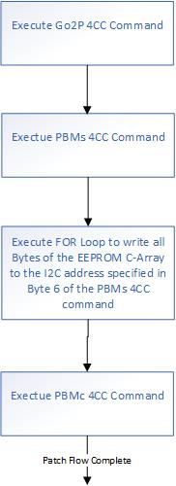
Patch Bundle Mode Flowchart
Use Go2P command to force PD controller to patch mode (PTCH) if PD controller is not in PTCH mode
Use PBMs command to start patch burst mode download sequence
Downloading the configuration to the specified I2C address
Use PBMc command to end the patch loading sequence and change device into “APP” mode

Slide 14
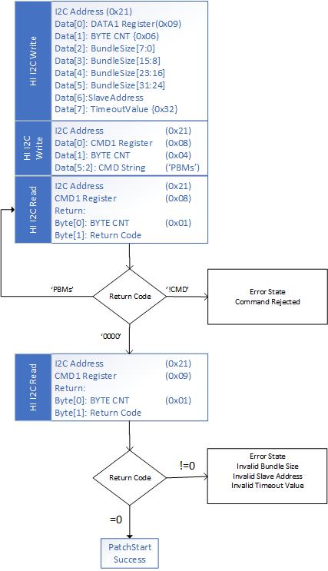
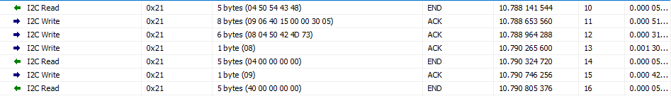
PBMs Pseudo Code with I2C Log Example (Address 0x21)

Slide 15
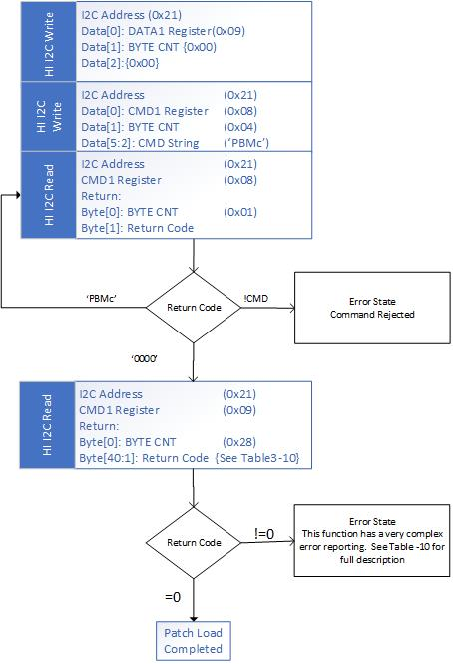
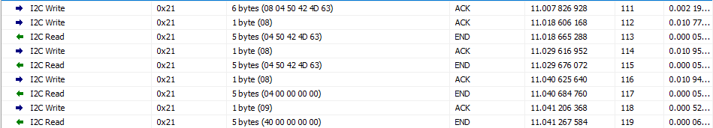
PBMc Pseudo Code with I2C Log Example (Address 0x21)

Slide 16
Moisture Detection

Slide 17
Moisture Detection Capabilities
Capabilities
1 | PD can power from VBUS or VIN_3V3
2 | CC and SBU are used to detect moisture
3 | Moisture can be detected with and without device being attached
4 | Moisture can be detected regardless of power role (DRP, Source, Sink)
5 | PD disables VBUS and CC automatically once moisture is detected
6 | PD triggers interrupt signal notifying system that moisture has been detected
7 | Configurable moisture detection threshold and hysteresis
8** | Detects if there is moisture present before applying VBUS **
** Feature may be removed due to Type-C compliance timing concerns

Slide 18
External Moisture Detection Circuit
Moisture could affect one or all resistances shown in the Connector/Cable section.
Series of external PFETs and NFETs connected to R_{UP} and R_{DN} toggle on/off
Either Q_{UP} or Q_{DN} will be enabled, not both at once.

Slide 19
FET Requirements
Only requirements for PFET and NFET is to be 20V tolerant

Slide 20
GPIO Events

Slide 21
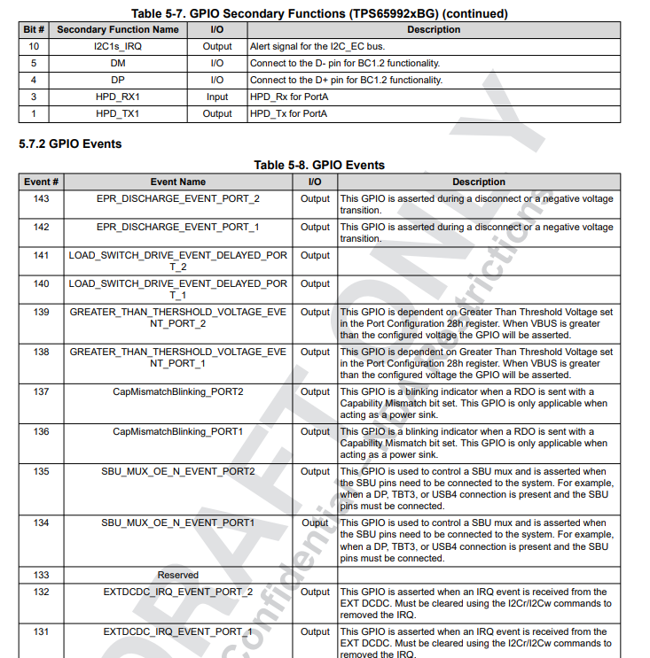
GPIO Events Table
Within the Host Interface Technical Reference Manual is a comprehensive list all the GPIO events

Slide 22

GPIO Events Table Example
There is a GPIO events that toggles High when the TPS65992SBG is operating as a sink
There is also a GPIO event that toggles high when a device has been attached regardless of power role, data role, or port partner characteristics

Slide 23
Detecting that a Harman Charger has been connected

Slide 24
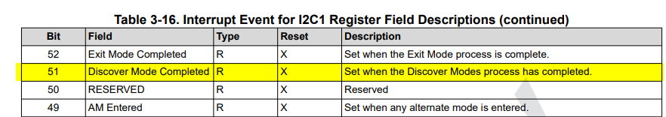
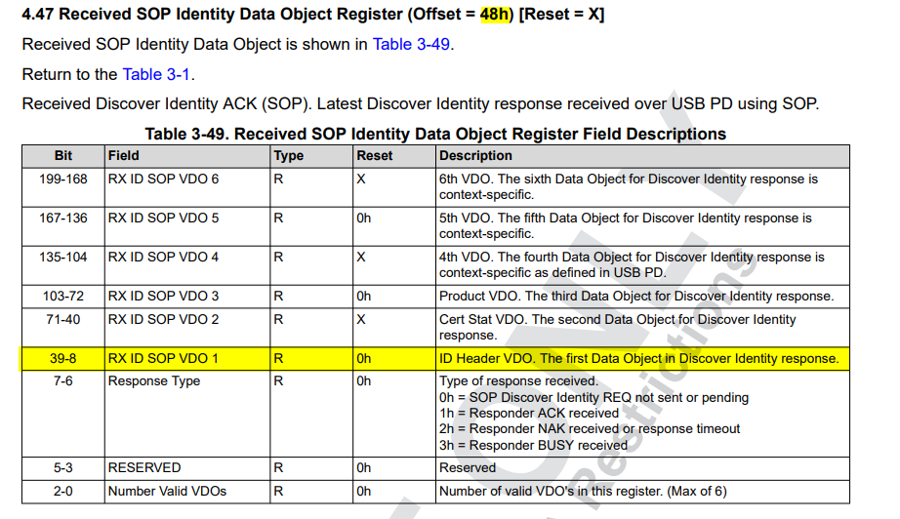
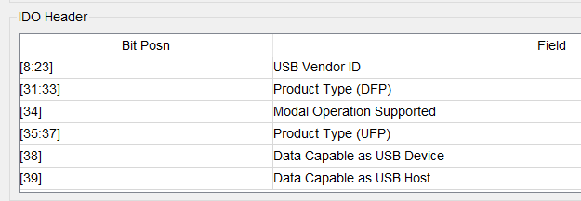
Detecting a Harman Charger is Connected
Enable IRQ event connected to “Discover Modes Completed”
When Discover modes process has completed, I2C IRQ pin will go low
When IRQ event is triggered low, read values from register 48h (received SOP Identity Data Object)
Harman Vendor ID will be stored in the “RX ID SOP VDO 1”

